Slide 1
Build Api using Express js
Made by:
Nag Varun Kondreddy

Slide 2
Objective
What is express Js?
Express Js installation
Usage
Object of express js
Routing in Express
Request and Response Object in Express
Middleware in express

Slide 3
What is express js?
Express.js is a node js web application server framework, which is specifically designed for building single page,multi-page and hybrid web application.

Slide 4
Installation
Install with NPM
Npm install express
To load express
Var express = require(‘express’);

Slide 5
Usage
Express module is factory for applications
Var app = express();
Invoke app.listen() method to create a server
app.listen(3000,function(req,res){
console.log(‘server is running’);});

Slide 6
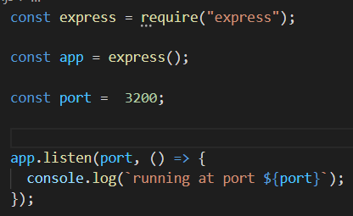
Example

Slide 7
Object of Express
There are 4 main object of express:
Application (app)
Request (req)
Response (res)
Router (express.Router)

Slide 8
Routing in Express
Routing refers to determining how an application responds to a client request to a
particular endpoint,which is a URI and specific HTTP request method (GET, POST, and so on).
SYNTAX :
app.method(PATH,HANDLER);
METHOD = GET/POST/PUT/DELETE etc

Slide 9
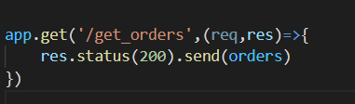
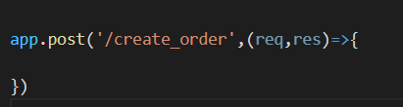
Routing Example

Slide 10
Route Patterns
Patterns can be strings or regular expression.
Strings can contain placeholders

Slide 11

Example

Slide 12
Requests object
Request objects expose details of HTTP requests:
req.params() => route parameters in URL.
Req.query => query string parameters
req.get() => get header value
Req. body() => parsed body
Req.path => path in URL

Slide 13
Responses Object
res.set() => set response headers
res.send() => write status with string
res.json() => stringify javascript value
res.redirect() => issue 301 or 302 redirect to URL

Slide 14
Middlewares In Express
Middleware performs the process before sending the request to the router.
Types of Middlewares:
Application level middleware
Router level middleware
Error handling middleware

Slide 15
Application Middleware
You can have multiple application level middleware.
Express framework provides app.METHOD.
List of methods:
App.get
App.post
App.put

Slide 16
Router middleware
Router middleware works as a separate component in express.
In route middleware, express binds instance of express.router object. This middleware is mainly used for configuring better routing.

Slide 17
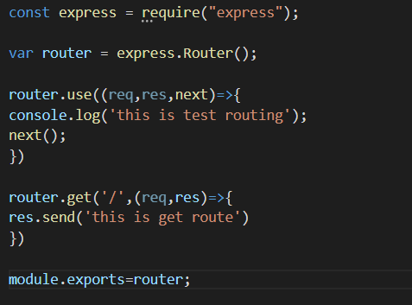
Example

